Slide 1

NATIONAL INSTITUTE OF TECHNOLOGY WARANGAL
PROJECT WORK - B
ENERGY THEFT DETECTION USING MACHINE LEARNING ALGORITHMS
Supervised by
Prof. M. Sailaja Kumari
Presented by
Raghav Rath (202249)
Kruthi pranada (202218)

Slide 2
INTRODUCTION
The objective of electricity theft detection is to detect unusual activities in the electricity usage of a smart meter.
Theft can be detected by checking for abnormalities in the user’s electricity consumption patterns.
The worst-hit are the developing economies.
Power theft and its illegal consumption results in immense economic loss for many countries such as India Rs 3,000 crores annually.
Power utilities are losing about 21 Billion Dollars globally, as power theft every year.

Slide 3
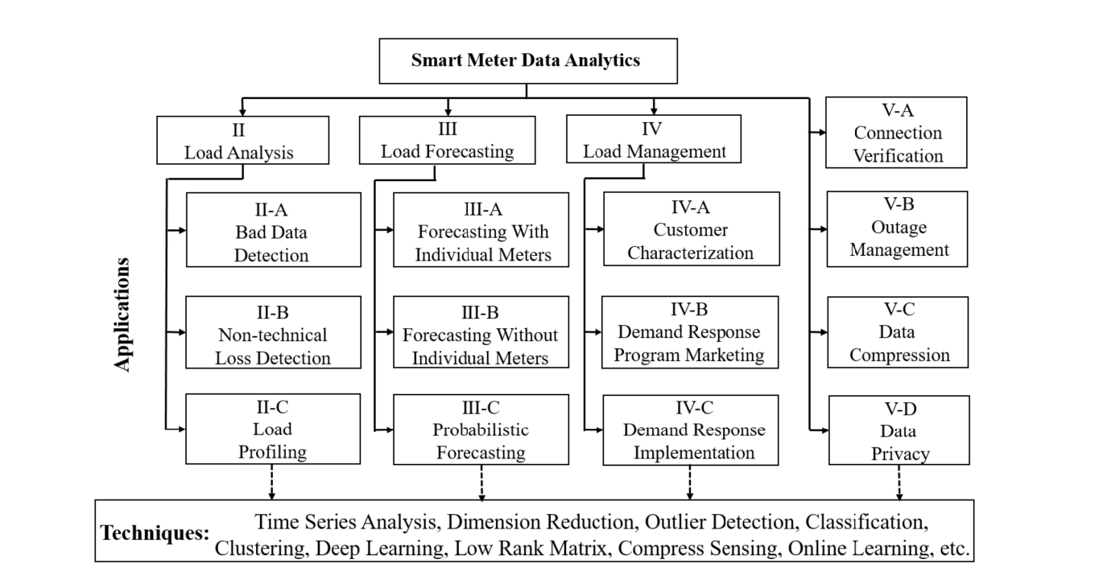
Y. Wang, Q. Chen, T. Hong, and C. Kang, “Review of Smart Meter Data Analytics: Applications, Methodologies, and Challenges,” in IEEE Transactions on Smart Grid, vol. 10, no. 3, pp. 3125-3148, May 2019, doi: 10.1109/TSG.2018.2818167.
https://ieeexplore.ieee.org/abstract/document/8322199

Slide 4
CONTENTS
INTRODUCTION
WORK DONE TILL MID
WORK DONE AFTER MID
Data Collection
Data Analysis
Modelling
Results
Conclusions
Objectives for Next Semester

Slide 5
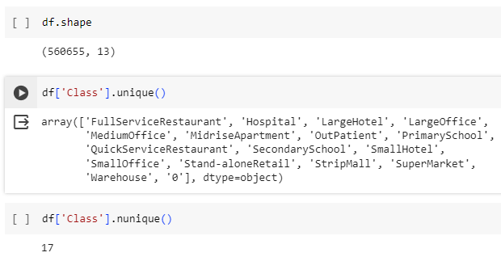
DATA SUMMARY
Data Statistics:
No of consumer types: 17
No of records: 5,60,655
No of features: 13
Columns Derived:
Total Energy
New Theft (Label)
S. Zidi, A. Mihoub, S. M. Qaisar, M. Krichen, and Q. Abu Al-Haija, “Theft detection dataset for benchmarking and machine learning based classification in a smart grid environment,” in Journal of King Saud University – Computer and Information Sciences, Received 21 February 2022, Revised 12 April 2022, Accepted 11 May 2022, Available online 17 May 2022.
https://www.researchgate.net/publication/360554845_Theft_Detection_Dataset_for_Benchmarking_and_Machine_Learning_based_Classification_in_a_Smart_Grid_Environment
DATASET:
https://data.mendeley.com/datasets/c3c7329tjj/1

Slide 6
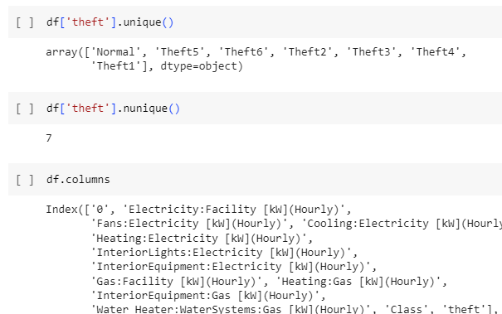
DATA SUMMARY
Theft types:
Theft 1: Considerable reduction of electricity consumption during the day.
Theft 2: Electricity consumption drops to zero at random and during an arbitrary period.
Theft 3: Consumption value (each hour) is multiplied by a random number.
Theft 4: A random fraction of the mean consumption.
Theft 5: The mean consumption.
Theft 6: Reverses the order of readings.

Slide 7
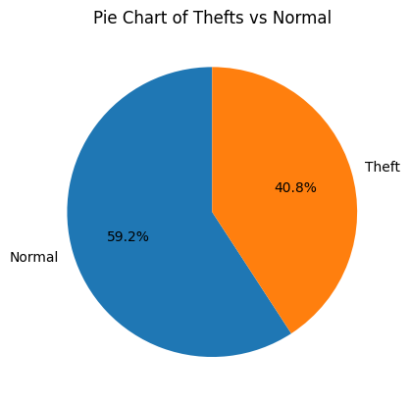
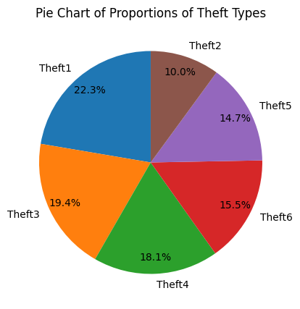
DATA ANALYSIS

Slide 8
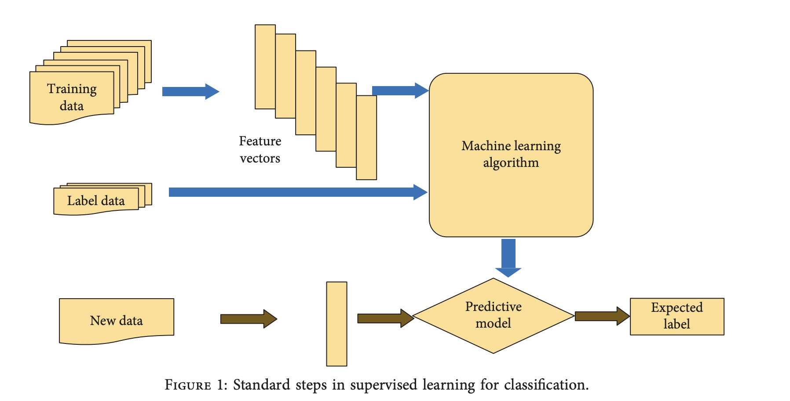

Slide 9
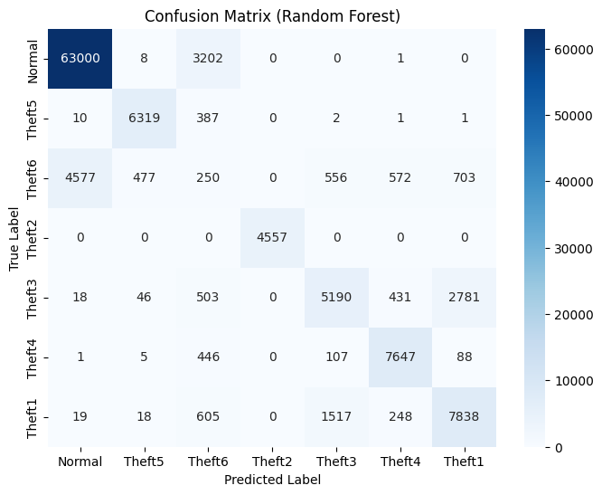
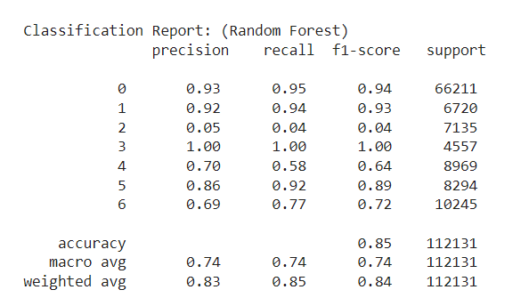
MODEL RESULTS (RANDOM FOREST)
Prediction on the test data

Slide 10
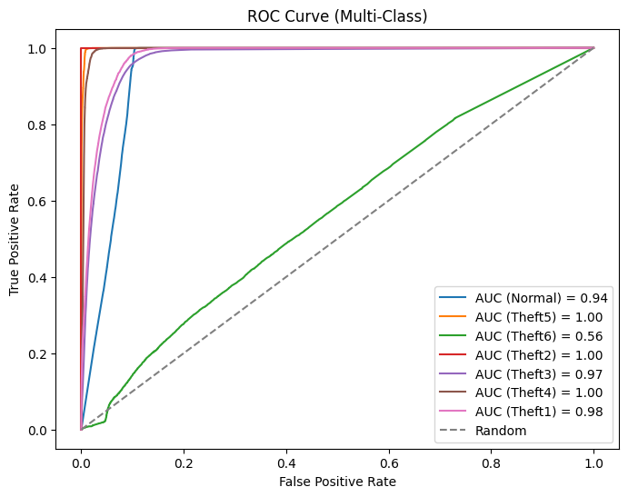
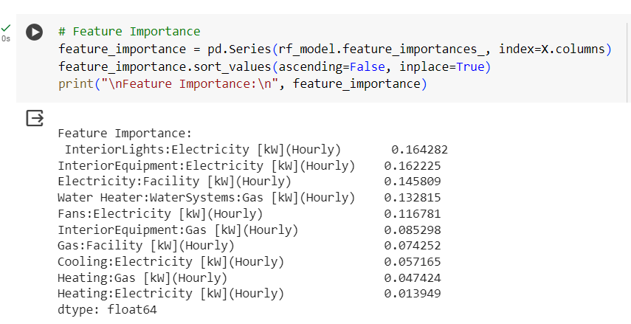
MODEL RESULTS (RANDOM FOREST)

Slide 11
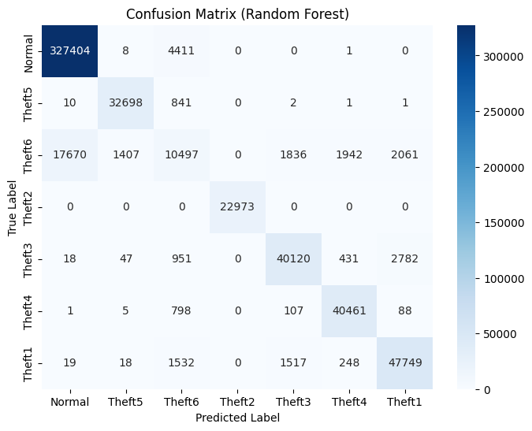
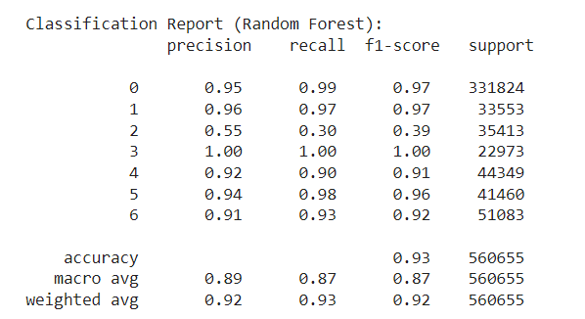
MODEL RESULTS (RANDOM FOREST)
Prediction on the entire dataset

Slide 12
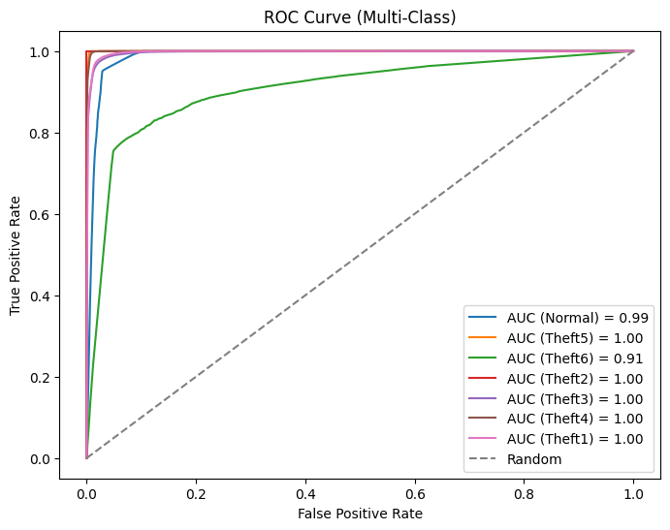
MODEL RESULTS (RANDOM FOREST)

Slide 13
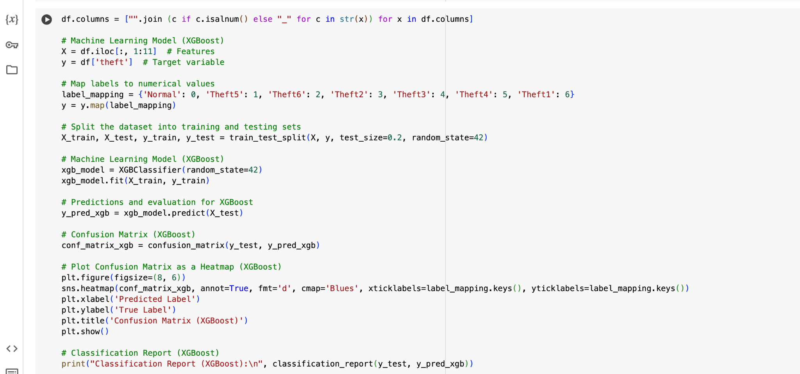
ALGORITHM USED FOR XGBOOST

Slide 14
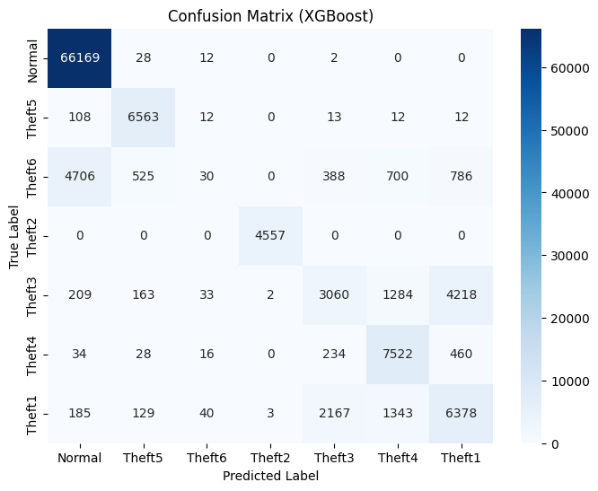
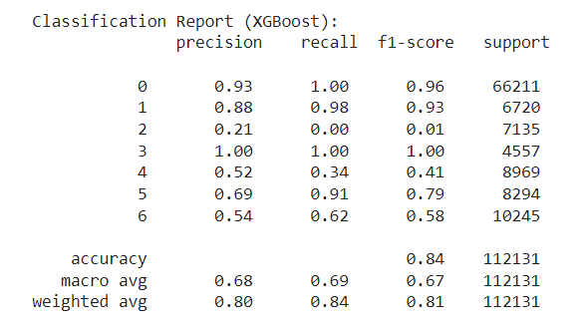
MODEL RESULTS (XGBoost)
Prediction on the test data

Slide 15
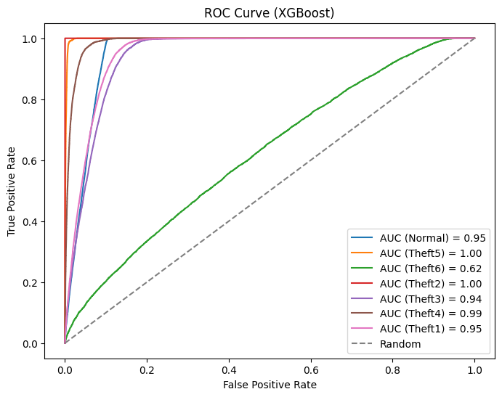
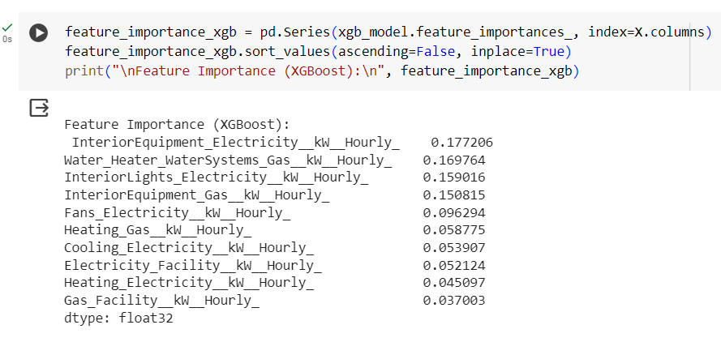
MODEL RESULTS (XGBoost)

Slide 16
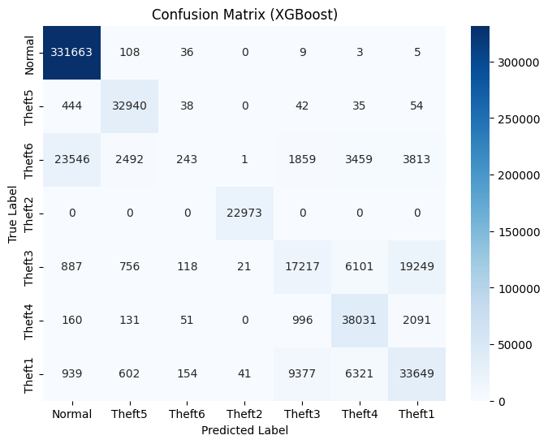
MODEL RESULTS (XGBoost)
Prediction on the entire dataset

Slide 17
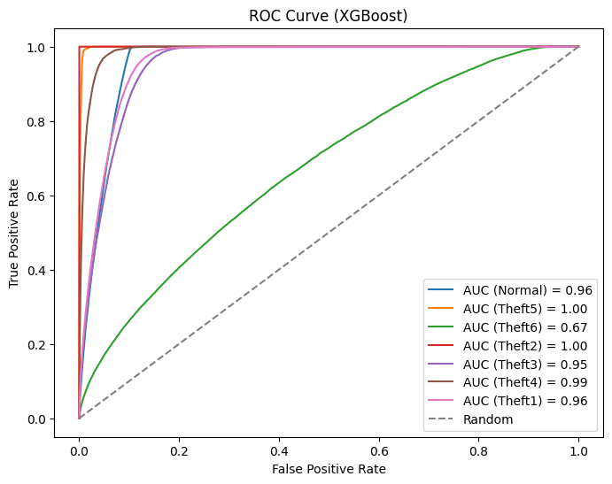
MODEL RESULTS (XGBoost)

Slide 18
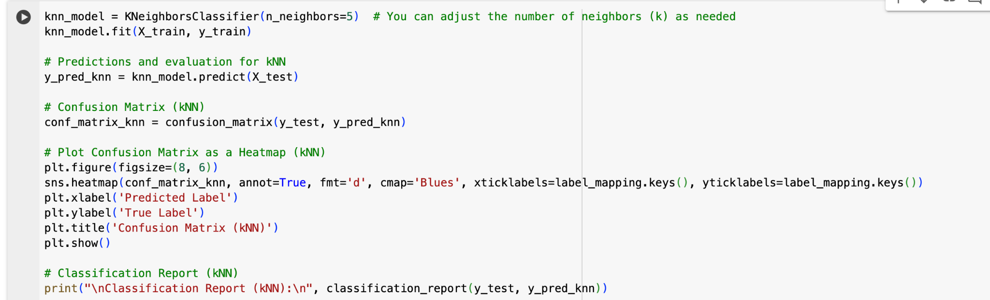
ALGORITHM USED FOR KNN

Slide 19
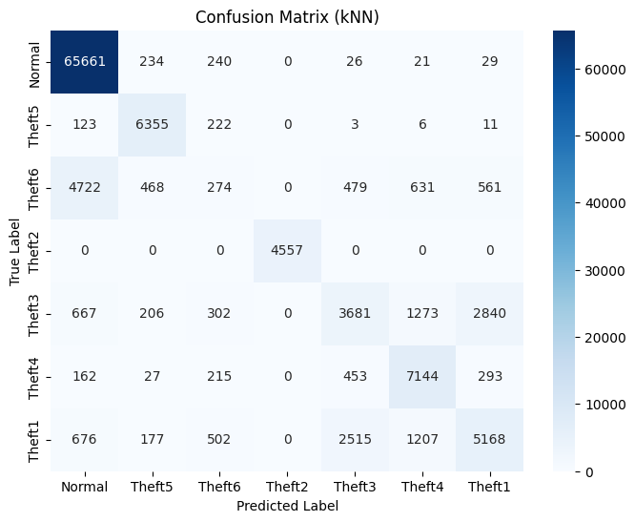
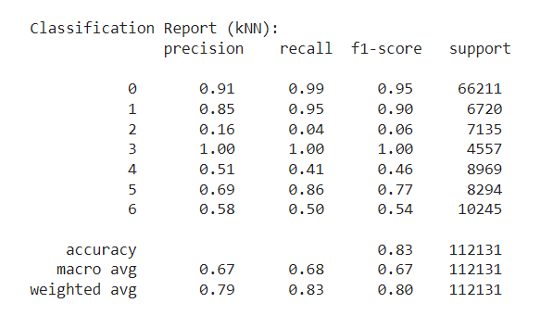
MODEL RESULTS (kNN)
Prediction on the test data

Slide 20
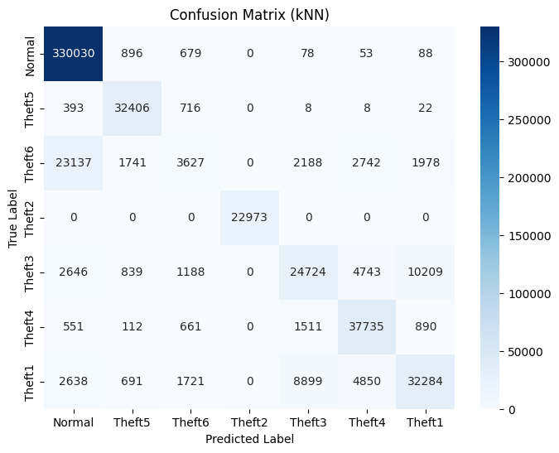
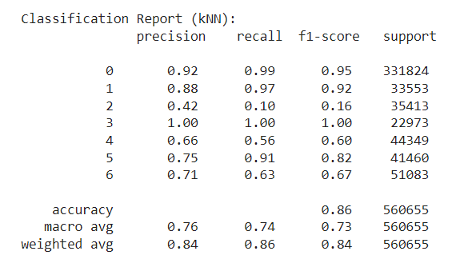
MODEL RESULTS (kNN)
Prediction on the entire dataset

Slide 21
CONCLUSIONS
Random Forest is the best ML model with the highest accuracy of 85%.
The predictions except for identifying ‘Theft 6’ are almost correct with very high precision and recall values.
XGBoost gives an accuracy of 84%.
However, XGBoost makes an error in identifying many ‘Theft3’ instances as ‘Theft 1’ apart from ‘Theft 6’.
There’s a considerable error in detecting in ‘Theft1’ also by XGBoost.
kNN gives an accuracy of 83%.
It also works similar to XGBoost.
Despite identifying ‘Theft 3’ better than XGBoost, it still identifies many instances as ‘Theft 1’ and vice versa.
Therefore, Random Forest is the ML model with the best performance.

Slide 22
CONCLUSIONS
For prediction on the entire dataset -
The accuracy of -
Random Forest has increased significantly from 85% to 93%.
kNN has increased slightly from 83% to 86%.
XGBoost is still the same.
Random Forest predicts ‘Theft 6’ significantly better (AUC of ROC has increased).
The precision of ‘Theft 1’ and ‘Theft 3’ prediction has increased significantly for kNN.
Random Forest shows better performance w.r.t all labels in prediction.
There is absolutely no change in the prediction performance of the XGBoost model.

Slide 23
WORK DONE LAST SEMESTER
Selection of problem statement.
Literature Review
Collection of data
Data Analysis
Machine Learning Modelling - Random Forest, XGBoost & k-NN.

Slide 24
WORK DONE THIS SEMESTER TILL MID
CNN METHOD
RNN METHOD
COMPARISON BETWEEN THE MODELS
SUITABLE AND EFFICIENT METHOD FOR EVERY THEFT.

Slide 25
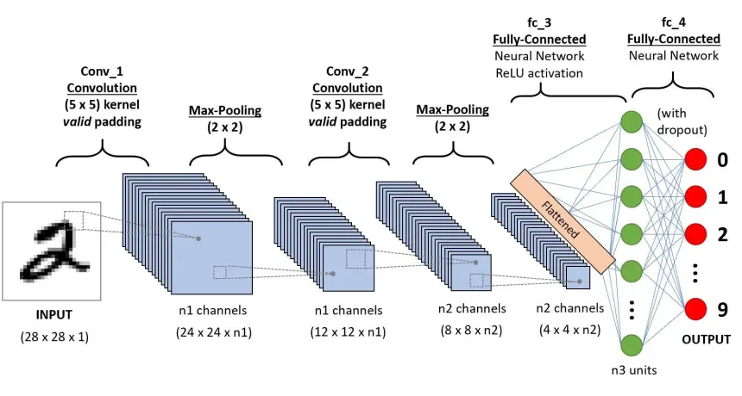
CNN ARCHITECTURE
https://www.analyticsvidhya.com/blog/2020/10/what-is-the-convolutional-neural-network-architecture/

Slide 26
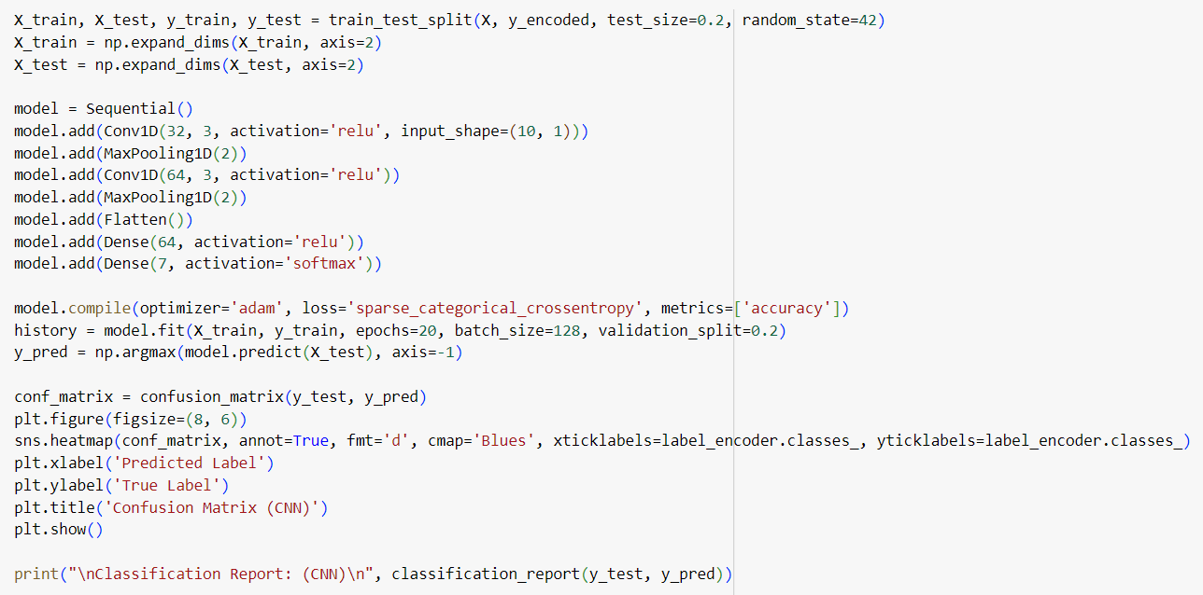
CNN CODE

Slide 27
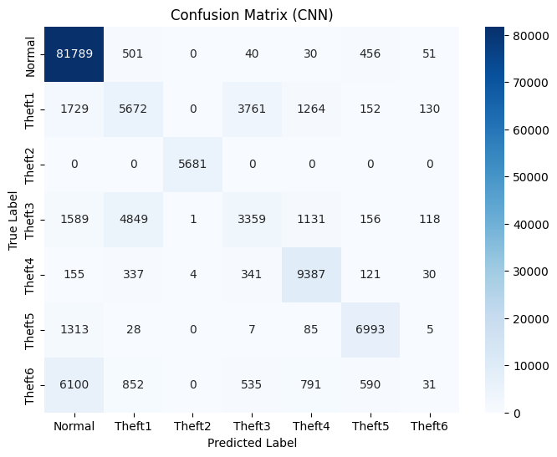
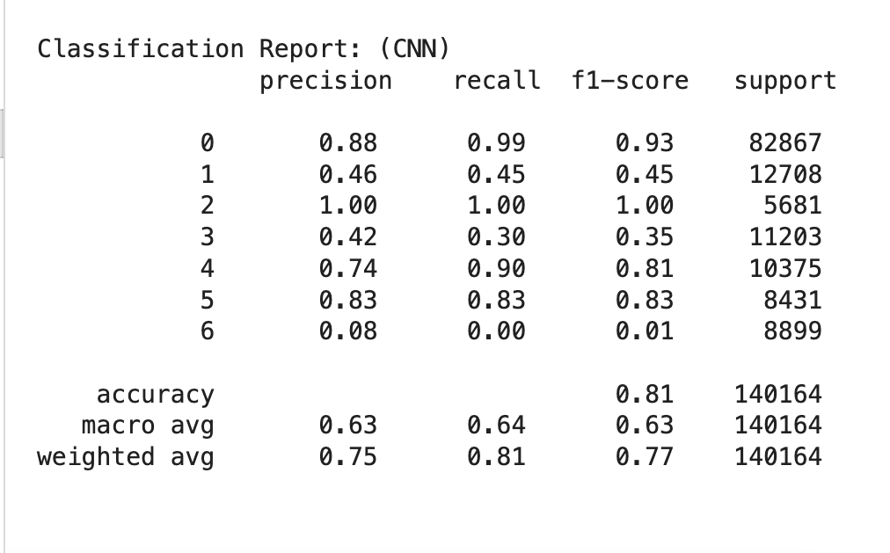
MODEL RESULTS (CNN)
Prediction on the test data set

Slide 28
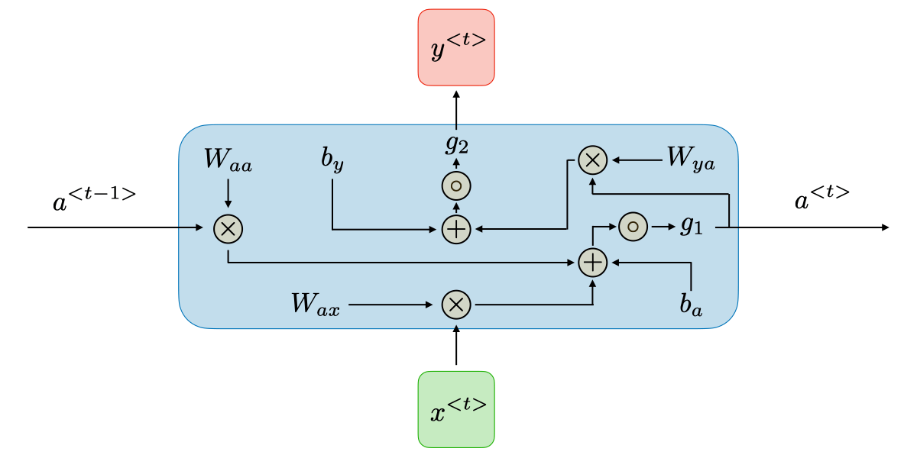
RNN ARCHITECTURE

Slide 29
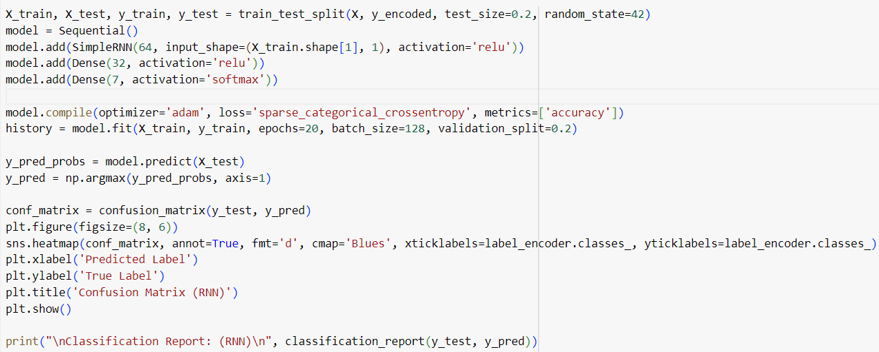
RNN CODE

Slide 30

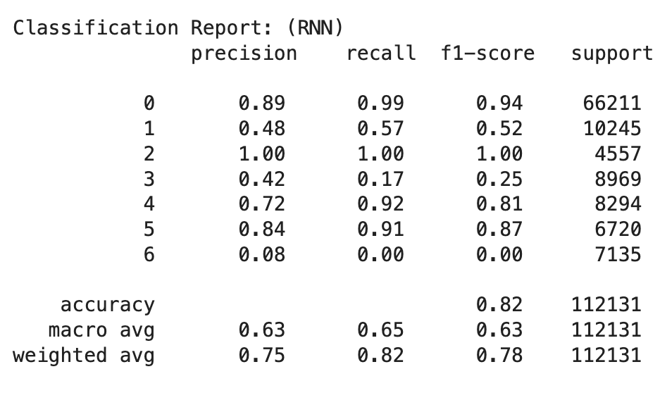
MODEL RESULTS (RNN)
Prediction on the test data set

Slide 31
COMPARISON BETWEEN MODELS
TEST DATA |  | RANDOM FOREST | XGBOOST | KNN | RNN | CNN
 | NORMAL | 0.93 | 0.93 | 0.91 | 0.89 | 0.88
 | THEFT 1 | 0.69 | 0.54 | 0.58 | 0.48 | 0.48
 | THEFT 2 | 1.00 | 1.00 | 1.00 | 1.00 | 1.00
PRECISION | THEFT 3 | 0.70 | 0.52 | 0.51 | 0.42 | 0.46
 | THEFT 4 | 0.86 | 0.69 | 0.69 | 0.72 | 0.74
 | THEFT 5 | 0.92 | 0.88 | 0.85 | 0.84 | 0.83
 | THEFT 6 | 0.05 | 0.21 | 0.16 | 0.08 | 0.10
ACCURACY | THEFT | 0.85 | 0.84 | 0.83 | 0.82 | 0.81

Slide 32
CONCLUSIONS
The accuracy of Convolutional Neural Network (CNN) and Recurrent Neural Network (RNN) are 81% and 82% respectively.
For the Deep Learning (DL) models, the precision of the ‘Theft4’ labels (72% and 74% for RNN and CNN respectively) have increased significantly when compared to XGBoost (69%) and k-NN (69%).
‘Theft6’ detection precision (8% and 10% for RNN and CNN respectively) has improved when compared to Random Forest (5%).

Slide 33

OBJECTIVES for END REVIEW
TRYING TO OPT NEW DEEP LEARNING METHODS LIKE ‘LSTM’.
IMPROVING THE PERFORMANCE OF THE MODELS

Slide 34
REFERENCES
Dataset: https://data.mendeley.com/datasets/c3c7329tjj/1
Y. Wang, Q. Chen, T. Hong, and C. Kang, “Review of Smart Meter Data Analytics: Applications, Methodologies, and Challenges,” in IEEE Transactions on Smart Grid, vol. 10, no. 3, pp. 3125-3148, May 2019, doi: 10.1109/TSG.2018.2818167.
https://ieeexplore.ieee.org/abstract/document/8322199
S. Zidi, A. Mihoub, S. M. Qaisar, M. Krichen, and Q. Abu Al-Haija, “Theft detection dataset for benchmarking and machine learning based classification in a smart grid environment,” in Journal of King Saud University – Computer and Information Sciences, Received 21 February 2022, Revised 12 April 2022, Accepted 11 May 2022, Available online 17 May 2022.
https://www.researchgate.net/publication/360554845_Theft_Detection_Dataset_for_Benchmarking_and_Machine_Learning_based_Classification_in_a_Smart_Grid_Environment
R. Punmiya and S. Choe, "Energy Theft Detection Using Gradient Boosting Theft Detector With Feature Engineering-Based Preprocessing," in IEEE Transactions on Smart Grid, vol. 10, no. 2, pp. 2326-2329, March 2019, doi: 10.1109/TSG.2019.2892595.
https://ieeexplore.ieee.org/stamp/stamp.jsp?tp=&arnumber=8610248
Z. A. Khan, M. Adil, N. Javaid, M. N. Saqib, M. Shafiq, and J. G. Choi, “Electricity Theft Detection Using Supervised Learning Techniques on Smart Meter Data,” in Sustainability, vol. 12, no. 19, pp. 8023, September 28, 2020, doi: 10.3390/su12198023.
https://www.mdpi.com/2071-1050/12/19/8023
J. Y. Kim, Y. M. Hwang, Y. G. Sun, I. Sim, D. I. Kim, and X. Wang, “Detection for Non-Technical Loss by Smart Energy Theft With Intermediate Monitor Meter in Smart Grid,” in IEEE Access, vol. 7, pp. 129043-129053, September 11, 2019, doi: 10.1109/ACCESS.2019.2940443.
https://ieeexplore.ieee.org/stamp/stamp.jsp?tp=&arnumber=8832141

